Slide 1

Port Authority Traffic and Violation Analysis Report
This comprehensive analysis examines the factors affecting bridge and terminal usage, toll violations, and traffic patterns across Port Authority facilities. Our team conducted extensive modeling using XGBoost regression, SARIMA time series analysis, and Random Forest Classification to identify key insights and provide strategic recommendations.
The following presentation outlines our findings on traffic patterns, violation rates, and the impact of external factors like weather, holidays, and NYC events on Port Authority facilities.

Slide 2

Contribution
Data Science & Modeling
Data Engineering
led XGBoost regression and SARIMA time series analysis. built the Random Forest Classifier for toll violations. conducted weather impact analysis and seasonality studies.
handled data cleaning, feature engineering for time variables and vehicle types, and prepared data for modeling and visualization phases.
Reporting & Visualization
edited the final report and formatted the dashboard. and designed the Power BI dashboard layouts and visualizations.

Slide 3










Factors Affecting Bridge and Terminal Usage
Time Factors
Month, time of day, day of week
Facility Location
GW Bridge, Holland Tunnel, etc.
Vehicle Type Mix
Autos, small trucks, large trucks
Weather Conditions
Precipitation, snow, temperature
Payment Type
EZPASS usage correlates with traffic flow
Our XGBoost regression model revealed that time-related variables and facility location had the highest feature importance scores. Weather conditions, particularly precipitation and snow events, consistently correlated with significant dips in traffic counts.

Slide 4

Toll Violation Analysis
9.5%
Violation Rate
Percentage of total transactions
98%
Model Accuracy
Random Forest Classifier performance
98%
Precision
For violation class identification
99%
Recall
For violation class identification
Our Random Forest Classifier achieved exceptional performance in identifying toll violations across Port Authority facilities. The Power BI dashboard visualizes total violators by facility and month, revealing clear patterns related to time, facility type, and weather conditions.

Slide 5
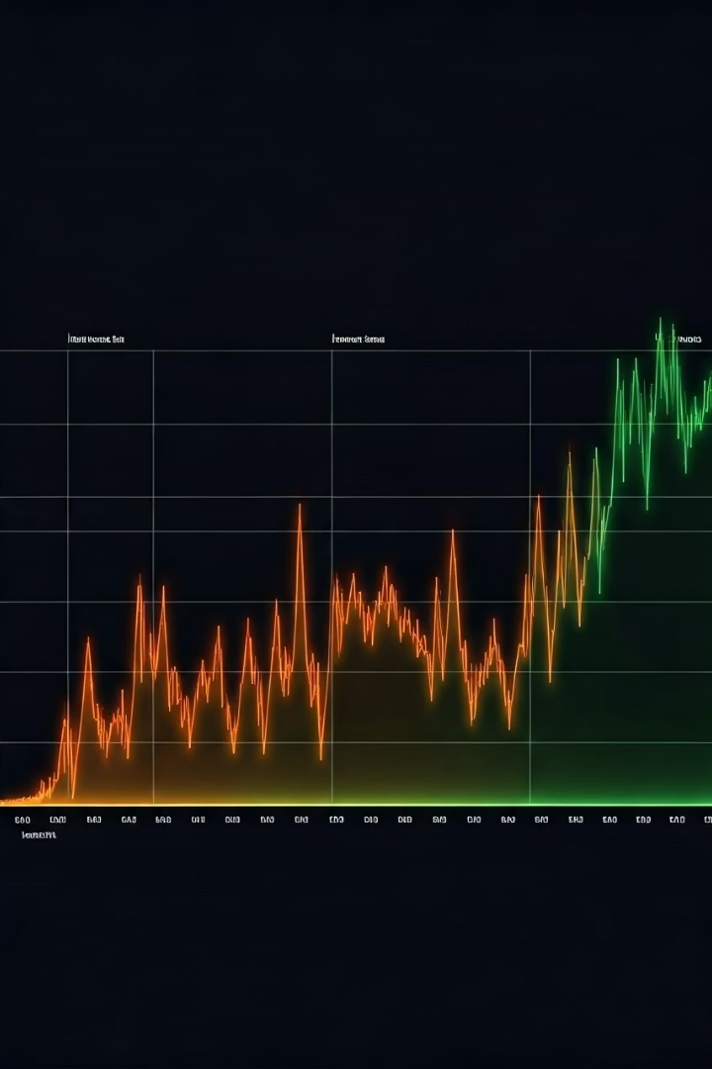




Traffic Patterns and Seasonality
Summer Months
June, July, and August show highest traffic volumes
Holiday Weekends
Thanksgiving, Christmas, and New Year's create traffic spikes
Peak Hours
Morning (7-10 AM) and evening (4-7 PM) rush hours
Winter Months
December-February show reduced traffic due to weather
Our SARIMA time series analysis captured clear seasonality trends in traffic patterns. Fridays and Sundays consistently show higher traffic volumes than midweek days. Weather events, particularly snowfall and heavy rain, significantly reduce traffic volume by 10-20% during event days.

Slide 6








Impact of NYC Events on Traffic
4th of July
Major Parades
Increased movement towards recreational sites via Outerbridge and GWB
Thanksgiving Day Parade causes traffic diversion spikes
Major Concerts
NYC Marathon
Events at Madison Square Garden and MetLife Stadium impact tunnel usage
Significant traffic pattern changes during route closures
Our analysis revealed that NYC events have a substantial impact on traffic patterns across Port Authority facilities. The Power BI dashboard maps these event-driven traffic trends, showing how different facilities experience varying levels of congestion during specific events.

Slide 7
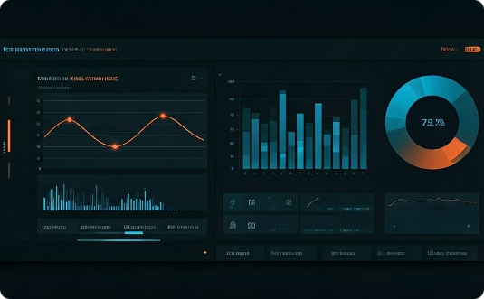

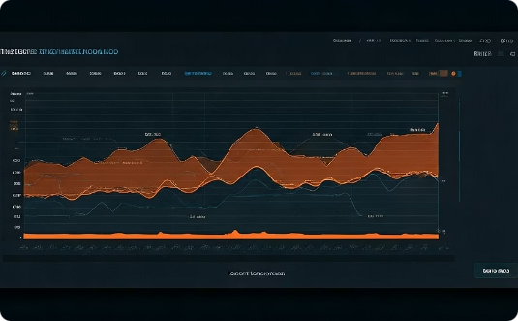
Power BI Dashboard Insights
Feature Importance
Violation Analysis
Seasonal Trends
Visualization of key factors affecting traffic volume across facilities, highlighting the relative importance of time, weather, and facility type.
Segmentation of toll violations by facility and time period, revealing patterns and potential enforcement opportunities.
Interactive visualization of traffic patterns by month, day of week, and time of day, with weather pattern overlays to show correlation.
Our comprehensive Power BI dashboard provides interactive visualizations for each project question, enabling stakeholders to explore the data and derive actionable insights for operational improvements.

Slide 8





Strategic Recommendations
Monitor Critical Factors
Track weather forecasts, focus resources on peak times (Friday afternoons, Sunday evenings, summer holidays), and enhance toll violation detection during high-traffic periods.
Operational Improvements
Expand EZPASS usage to improve throughput and consider dynamic toll adjustments during peak holiday weekends to distribute demand more evenly.
Enhanced Data Collection
Implement special event tagging, deploy IoT sensors for real-time speed data, and incorporate exogenous factors like gas prices and public transit disruptions.
Strategic Initiatives
Invest in predictive maintenance during low-traffic windows and improve public communication through dynamic digital boards and mobile apps.

